Slide 1
HIP Project Expo
Cincinnati Campus
June 11, 2014
HIP Mentee Name
Group #, Class, High School Name

Slide 2


Ethan Link
UC 2024
Grace Gamstetter
Cyber Software Engineer
Travis Carney
Cyber Software Engineer
Matt Stephan
Cyber Software Engineer
University of Cincinnati
Computer Science

Slide 3
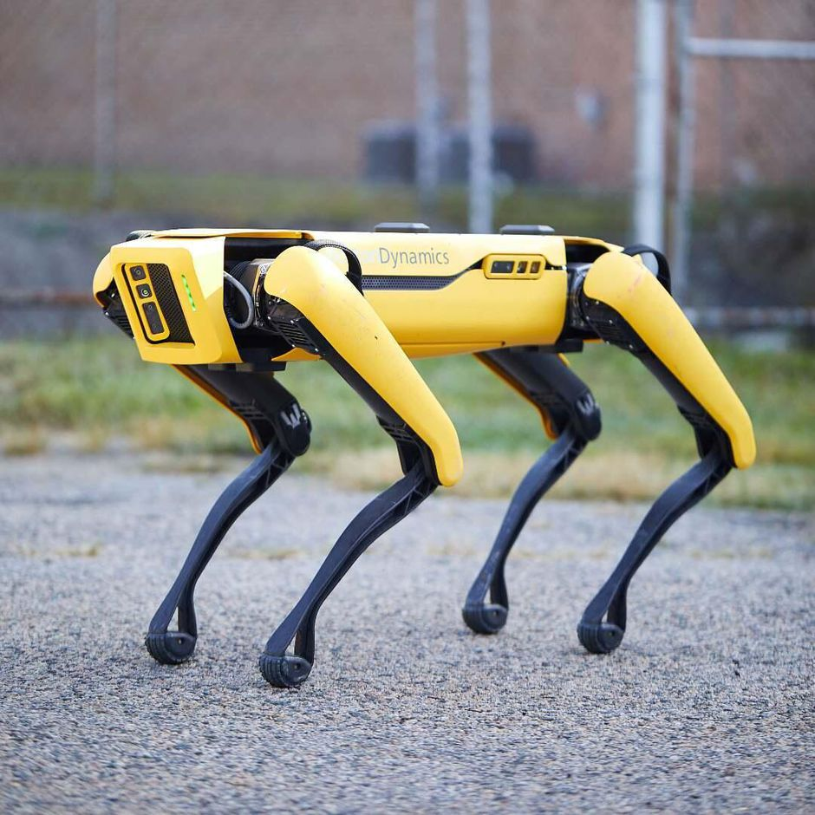
Project Description / Background
                The goal of the project was to build a semi-autonomous robot.
                Wanted to learn more about embedded computer systems and mechanics.
                Inspired by Boston Dynamics, the world leader in mobile robots.
Inspiration for Robot

Slide 4
Approach / Process
Developed Theoretical Models, and requirements list for the robot
Priced parts and developed CAD models
Developed Software to allow for control of each of the leg designs
Created Electrical Schematic to prototype electrical design for the robot
Used CAD models to design mechanical system.
Requirements
Detailed
Design
Fabrication
&
Assembly
Design Verification
& Test

Slide 5
Analysis/Results
Created electrical schematic for robot
Developed logic flow for the robot if it were to be programmed.
Designed Chassis and legs for the robot if it were to be built.
Developed communication system for ICs

Slide 6
Learning Highlights /Conclusion
  Learning Highlights
    Tensor Flow requires processing power out of scope for a robot with on board computing
    Used CAD to model robot components
    Tested power usage of each component to determine how to safely/efficiently design the robot's electrical system
    Conclusion:
    Robot Could not be completed due to the change in setting due to circumstances beyond our control

Slide 7
Future Work / Connection to NGC
Future Work
  After the current situation ends, the robot could be assembled
  Add Arm to the robot
Related Technology
  Linux
  Transistors
  Serial Communication
  Mechanical Engineering
  Embedded Technology
  Software Development (C++, Python)

